Slide 1

CSE 207: Computational Complexity
Dr. Md. Shamsuzzoha Bayzid
Department of Computer Science and Engineering Bangladesh University of Engineering and Technology

Slide 2
Computational Complexity
In many search problems, we have to find the optimal solution from an exponentially large number of possible solutions
Shortest path problem
Minimum spanning tree
Surprisingly, we have polynomial time solutions to some of them
These are exceptions!
But there are many problems for which we don’t have any efficient algorithm
Efficient algorithms: O(n^{k}) time algorithm (that’s the norm)

Slide 3


Computational Complexity
There are many problems for which we don’t have any efficient algorithm
How do you know there is no efficient solution (like the lower bound on comparison based sorting)?
I cannot solve it efficiently because I am dumb!
I cannot find an efficient solution because there isn’t any!
Image credit: “Computers and Intractability” by Garey and Johnson

Slide 4
Computational Complexity
It is really hard to prove that there is no efficient algorithm for a particular problem.
How do you know there is no efficient solution (like the lower bound on comparison based sorting)?
What to do?
Show that the problem is as hard as many other problems that have been worked on by a host of brilliant scientists over a very long time, yet there is no efficient solutions
A fundamental aspect of complexity theory is categorizing problems into such equivalence classes
Comparing relative difficulty of different problems

Slide 5
Computational Complexity
Decision problems are suitable for this framework
A decision problem is a problem whose output is a single boolean value: YES or NO.
Given a CNF Boolean formula, is there any satisfying assignment?
(X v Y v Z) ^ (X’ v Y’ v Z)
Conversion:
Shortest path (Optimization problem): Find the shortest path between two nodes s and t in a graph G
Shortest path (Decision problem): Is there a path P between s and t in G such that p <= x?
Do you see why a bound (p <=x) is required here?

Slide 6
P and NP
P: Set of decision problems that can be solved in polynomial time
Relatively easier problems that can be solved quickly!
NP: Set of decision problems with a polynomial time verification for a “YES” answer
We can verify a “YES” answer if we have the solution in front of us.
Formally, given an input (instance) I and a solution S, we can efficiently check whether S indeed corresponds to the “YES” answer.
Hard to find, but easy to recognize!

Slide 7
P and NP
Example: Is the following Boolean formula satisfiable?
(X v Y v Z) ^ (X’ v Y’ v Z)
There is no efficient algorithm (to date) to solve this decision problem. May not be in P (but nobody knows)
What if we are given an assignment and just need to verify whether it satisfies the given Boolean formula?
I: (X v Y v Z) ^ (X’ v Y’ v Z); S: X = 1, Y = 0, Z = 1
We can check in polynomial time whether S satisfies I.
The satisfiability problem is in NP!
Do you see why there is no efficient algorithm to verify the “NO” answer?

Slide 8
Optimization vs. Decisions/search problem
Turning an optimization problem to a search problem does not necessarily change its difficulty.
They reduce to one another!
?
How?
Solving the optimization problem readily solves the decision
Find the shortest path and see if it is within the budget
You can also know the shortest path by using the solutions to the decision problem.
Do you see how? - repeatedly doing optimal problems, it can be binary search

Slide 9
P and NP
P is a subset of NP
Every decision problem in P is also in NP.
x є P => x є NP
There is a polynomial time algorithm A which solves problem x. Therefore, an efficient certifier B just ignore the certificate and solves the problem from scratch. That means B will run A and returns the output of A.

Slide 10
P and NP
Is NP a subset of P? P = NP?
Is there a problem in NP that does not belong to P? P ≠ NP?

Slide 11
What we think the world looks like
NP
P

Slide 12
Complement of a problem
For every problem X, there is a natural complementary problem X’
If the answer to X is “YES”, the answer to X’is “NO”
SAT: Is a given boolean formula in CNF satisfiable?
UNSAT: Is a given boolean formula in CNF unsatisfiable?

Slide 13
Complement of a problem
x є P => x’ є P
We have an efficient algorithm A to solve X.
We can design an algorithm A’ for X’ which runs A
and flip the answer

Slide 14
Complement of a problem
Is it true that x є NP => x’ є NP?
Just because you have an efficient certifier for X does not mean that you can design an efficient certifier for X’
YES answers verification involves “there exist” quantifier, whereas NO answer verification involves “for all”

Slide 15
co-NP
x є NP => x’ є co-NP
co-NP: Set of decision problems with a polynomial time verification for a “NO” answer
Just the opposite to NP
UNSAT: Is a given Boolean formula unsatisfiable?
UNSAT є co-NP
Notes:
If the answer of an UNSAT instance is “NO”, it means it is satisfiable. That means you will have a certificate that will satisfy the given formula. So you can verify this certificate in polynomial time.

Slide 16
co-NP
PRIME: Is a given number x prime?
NO answer verification is easy; PRIME is in co-NP
YES answer verification does not seem to be easy
PRIME is in P (Agrawal, Kayal, and Saxena (AKS))

Slide 17
NP and co-NP
Does NP = co-NP?
We don’t know yet!
What is the relationship between P and co-NP?
P is a subset of co-NP
x є P => x є co-NP
If the answer is NO for a problem and you can solve it in polynomial time, you can verify the NO answer without looking at the certificate

Slide 18
NP and co-NP
What is the relationship between P and co-NP?
P is a subset of co-NP
x є P => x’ є P => x’ є NP => x є co-NP
x є P => x є co-NP

Slide 19
What we think the world looks like
co-NP
NP
P

Slide 20
P, NP, co-NP
Just like P and NP, the widespread belief is that
NP ≠ co-NP
But we don’t know!
Proving NP ≠ co-NP is even a bigger step than proving P ≠ NP
x є P => x’ є P => x’ є NP => x є co-NP

Slide 21
P, NP, co-NP
NP ≠ co-NP => P ≠ NP
P = NP => NP = co-NP
P is closed under complementation. So if P = NP, then
NP = P = çomplement of P = co-NP
NP is a subset of co-NP
x є NP => x є P => x’ є P => x’ є NP => x є co-NP
co-NP is a subset of NP
x є co-NP => x’ є NP => x’ є P => x є P => x є NP

Slide 22
Assignment
Assignment
“It is possible that P ≠ NP, yet NP = co-NP”
Do you agree with this statement? Justify your answer

Slide 23
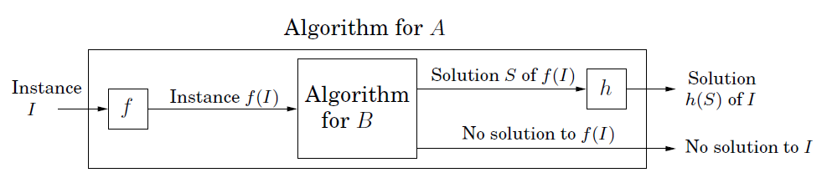
Polynomial-time Reductions
Reduction
A ≤p B
Problem A is polynomial time reducible to problem B
If A ≤p B and if we have a blackbox that solves B, then we can solve A by reducing and instance of A into an instance of B
Image credit: “Algorithms”, Das, Gupta, and Vazirani

Slide 24

Polynomial-time Reductions
Reduction
A ≤p B
Problem A is polynomial time reducible to problem B
A is at least as hard as B
B is at least as hard as A

Slide 25
Polynomial-time Reductions
Reduction
A ≤p B
Problem A is polynomial time reducible to problem B
If you can solve B in polynomial time,
then you can solve A in polynomial time
If you cannot solve A in polynomial time,
then you cannot solve B in polynomial time
Difficulty flows from A to B;
Efficiency flows from B to A

Slide 26
NP-hard problems
NP-hard
Problem X is an NP-hard problem if
for all Y є NP, Y ≤p X
A problem X is NP-hard if a polynomial-time algorithm for X would imply a polynomial-time algorithm
for every problem in NP.

Slide 27
NP-complete problems
NP-complete
Problem X is an NP-complete problem if:
i) X є NP
ii) for all Y є NP, Y ≤p X
NP-complete problems are the hardest problems in NP
NP-complete is a set of problems with the “same level of” difficulty
Notes:
Same level of difficulty because each problem in NPC can be reduced to others. So they define both upper bound and lower bound on the difficulty. However, NP-hard problems define a lower bound. Because it is possible that one NP-hard cannot be reduced to another NP-hard.

Slide 28
What we think the world looks like
NP-hard
NP-complete
co-NP
NP
P

Slide 29
Proof of NP-completeness
NP-complete
You have to prove that for all problems Y є NP, Y ≤p X
Alternative: Prove that a known NP-complete problem Y ≤p X

Slide 30
Vertex Cover
A vertex cover of a graph is a set S of nodes such that every
edge has at least one endpoint in S.
We try to “cover” each of the edges by choosing at
least one of its vertices.
Vertex Cover
Given a graph G and a number k, does G contain a vertex cover
of size at most k.
Notes:
a vertex cover (sometimes node cover) of a graph is a set of vertices that includes at least one endpoint of every edge of the graph.
Minimal set of vertex cover diye prottek ta edge cover hobe

Slide 31
Vertex Cover
Vertex Cover
Given a graph G and a number k, does G contain a vertex cover
of size at most k.
1
2
Is there a vertex cover of size 4?
Yes
3
4
5
6
7
8
9
10
11

Slide 32
Vertex Cover
Vertex Cover
Given a graph G and a number k, does G contain a vertex cover
of size at most k.
Is there a vertex cover of size 4?
Yes
Is there a vertex cover of size 3?
No
1
2
3
4
5
6
7
8
9
10
11

Slide 33
Independent Set
An independent set of a graph is a set I of nodes such that
they are pairwise non-adjacent.
Independent Set
Given graph G and a number k, does G contain a set of at least k
independent vertices?
Notes:
an independent set, stable set, coclique or anticlique is a set of vertices in a graph, no two of which are adjacent.

Slide 34
Independent Set
Independent Set
Given graph G and a number k, does G contain a set of at least k
independent vertices?
Is there a vertex cover of size 4?
Yes
Is there a vertex cover of size 3?
No
1
2
3
4
5
6
7
8
9
10
11

Slide 35
Independent Set
Independent Set
Given graph G and a number k, does G contain a set of at least k
independent vertices?
Is there an independent set of size 4?
Yes
1
2
3
4
5
6
7
8
9
10
11

Slide 36
Independent Set to Vertex Cover
Independent Set
Given graph G and a number k, does G contain a set of at least k
independent vertices?
Vertex Cover
Given a graph G and a number k, does G contain a vertex cover
of size at most k.
Notes:
Clique Problem

Slide 37
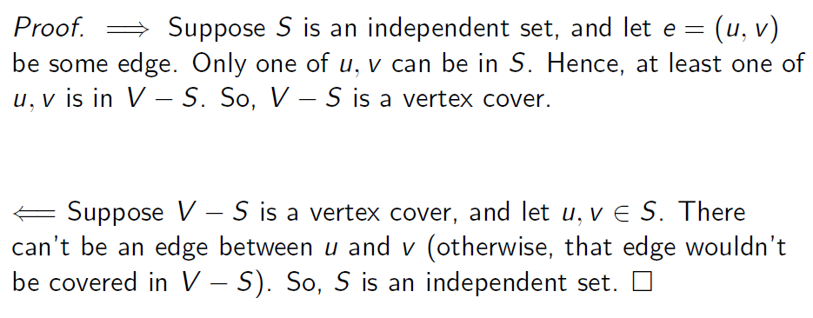
Independent Set to Vertex Cover
Theorem
If G = (V,E) is a graph, then S is an independent set if and only if
V-S is a vertex cover.
Carl Kingsford, Carnegie Mellon University

Slide 38
3-SAT to Independent Set
Input
An instance of 3-SAT with X = {x₁, x₂, …, x_{n}} variables
and k clauses C₁, C₂, …,C_{k}
(x ∨ y ∨ z) ∧ (x’ ∨ y’ ∨ p) ∧ (y ∨ z’ ∨ p’)

Slide 39
3-SAT to Independent Set
Non-trivial reduction as the problems are quite different in nature
A clique (triangle for a clause with three variables) for every clause
An edge between x and x’ in two different clauses
(x ∨ y ∨ z) ∧ (x’ ∨ y’ ∨ p) ∧ (y ∨ z’ ∨ p’)
x
x’
y
y
z
y’
p
z’
p’

Slide 40
3-SAT to Independent Set
x
x’
y
y
z
y’
p
z’
p’
Satisfiable ⇒ ∃ an independent set
If the instance of 3-SAT is satisfiable , then each triangle in our graph contains at least one node which evaluates to 1
Let S be a set consisting of one such node from each triangle. Then S is an independent set. Because, if S contains two adjacent vertices then both of them cannot be 1. So there is no pair of vertices with edge in S.

Slide 41
3-SAT to Independent Set
x
x’
y
y
z
y’
p
z’
p’
∃ an independent set of size k ⇒ Satisfiable
First, we claim that |S| = k (exactly k and it contains exactly one node from each clause). This is true because if you pick more than a two nodes from a triangle, it will not be an independent set.
Next, we prove that we can assign values (0/1) to the variables in the instance of 3-SAT problem so that it evaluates to 1

Slide 42
3-SAT to Independent Set
x
x’
y
y
z
y’
p
z’
p’
∃ an independent set of size k ⇒ Satisfiable
If x_{i} is present in the independent set (IS), x_{i} = 1
If x’_{i} is present in the independent set (IS), x_{i} = 0
If both x’_{i} and x_{i} are absent, assign any value to x_{i} (doesn’t matter)
In this example, {x, p, z’} is an IS.
x = 1, p = 1, z = 0 will satisfy the formula

Slide 43
Vertex Cover to Set Cover
Vertex Cover
Given a graph G and a number k, does G contain a vertex cover
of size at most k.
Set Cover
Given a set U of n elements, a collection of S₁, S₂, …, S_{m}
of subsets of U, is there a collection of
at most k of these subsets whose union equals U?
Notes:
Set cover e jeshob set nibo tader union Universal er shoman hobe

Slide 44
Vertex Cover to Set Cover
u₂
u₆
U = {1, 2, 3, 4, 5, 6, 7,8}
S₁ = {1, 2, 3}
S₂ = {1, 4}
S₃ = {3, 6}
S₄ = {4, 5, 6,7}
S₅ = {2, 5}
S₆ = {7, 8}
S₇ = {8}
1
7
8
4
u₁
u₅
u₄
u₇
2
5
3
6
u₃
U = E (the set of edges)
For each vertex u_{i}, create a subset S_{i} such that S_{i} contains all the edges incident to u_{i}

Slide 45
Vertex Cover to Set Cover
u₂
u₆
U = {1, 2, 3, 4, 5, 6, 7,8}
S₁ = {1, 2, 3}
S₂ = {1, 4}
S₃ = {3, 6}
S₄ = {4, 5, 6,7}
S₅ = {2, 5}
S₆ = {7, 8}
S₇ = {8}
1
7
8
4
u₁
u₅
u₄
u₇
2
5
3
6
u₃
∃ a set cover of size at most k ⇒ ∃ a vertex cover of size at most k
If S₁, S₂, …, S_{l} ; l <= k is a set cover of U, then every edge in G is a incident to one of the vertices in corresponding to the subsets S₁, S₂, …, S_{l}. Therefore, there is a vertex cover of size l <= k.

Slide 46
Vertex Cover to Set Cover
u₂
u₆
U = {1, 2, 3, 4, 5, 6, 7,8}
S₁ = {1, 2, 3}
S₂ = {1, 4}
S₃ = {3, 6}
S₄ = {4, 5, 6,7}
S₅ = {2, 5}
S₆ = {7, 8}
S₇ = {8}
1
7
8
4
u₁
u₅
u₄
u₇
2
5
3
6
u₃
∃ a vertex cover of size k ⇒ ∃ a set cover of size k
If {u₁, u₂, …, u_{k}} is a vertex cover in G, then by construction,
S₁ ∪ S₂ ∪ … ∪ S_{k} = U (since U is the set of all edges).

Slide 47
Hamiltonian Cycle Problem: A Hamiltonian cycle is a cycle in a graph that visits each vertex exactly once. The Hamiltonian cycle problem is, given an undirected graph, is to answer whether the graph contains a Hamiltonian cycle. The Hamiltonian cycle problem is known to be NP-complete.
Travelling Salesperson Problem (TSP): Given a set of cities and distance between every pair of cities, the problem is to find the shortest possible route that visits every city exactly once and returns to the starting point.
Prove that the travelling salesperson problem is NP-complete. You can model TSP using an undirected weighted graph.

Slide 48
Reduction
Warning
You should reduce the known NP-complete problem
to the problem you are trying to prove NP-complete.
You will mistakenly do the opposite sometimes!

